Slide 1
TWISTER Full System
Compliance Tool

Slide 2
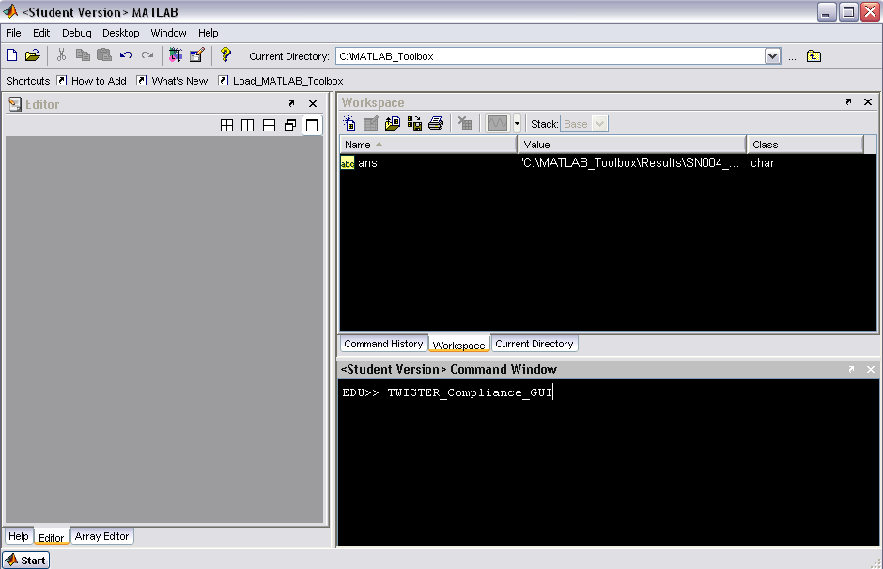
Load TWISTER Tools, then type “TWISTER_Compliance_Tool” a the command line.

Slide 3
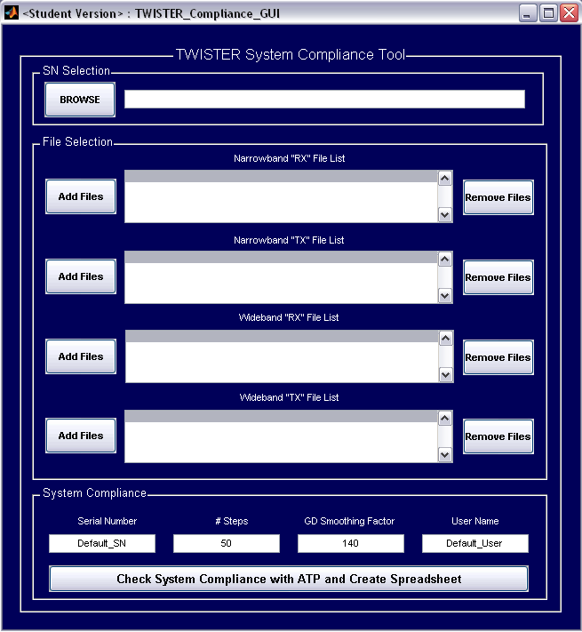
TWISTER_Compliance_GUI will open.

Slide 4
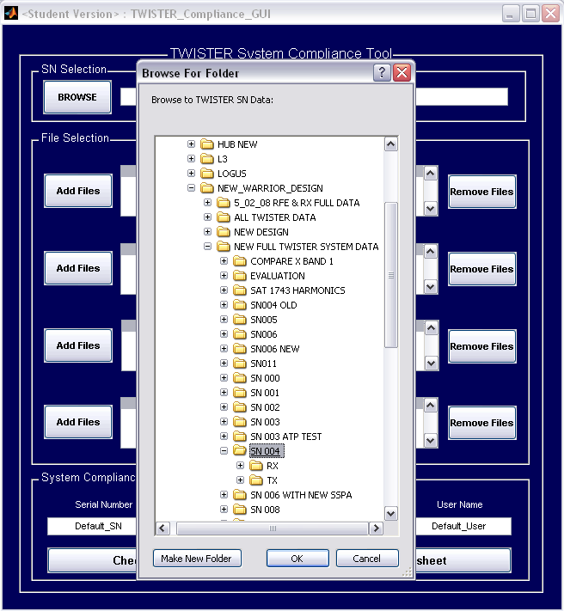
Browse to the correct Serial Number directory.

Slide 5
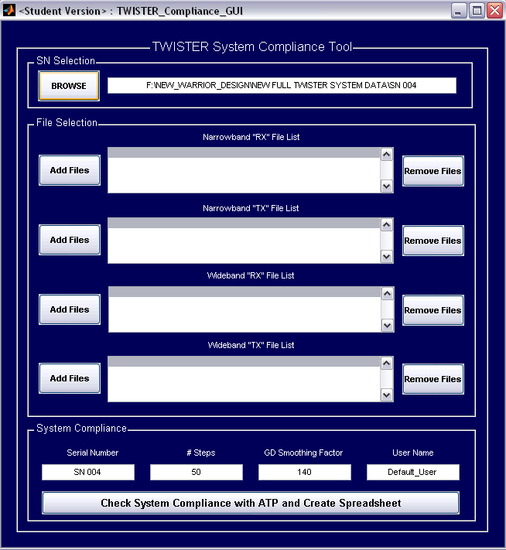
GUI will display selected directory.

Slide 6
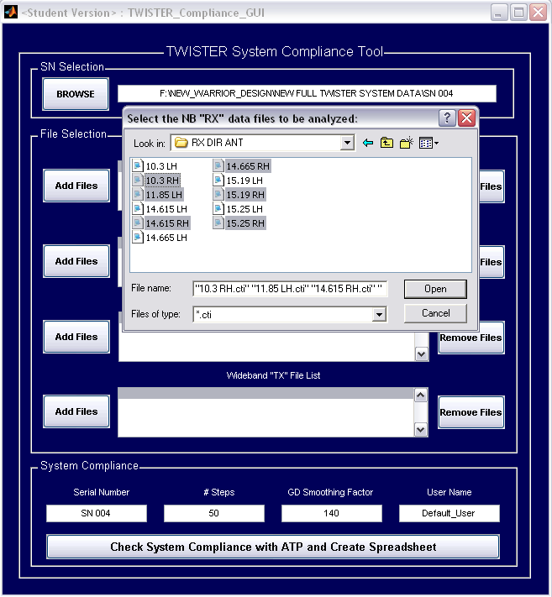
Begin selecting data files for analysis, starting with NB “RX” Antenna. (Accepts *.cti and *.s2p files.)

Slide 7
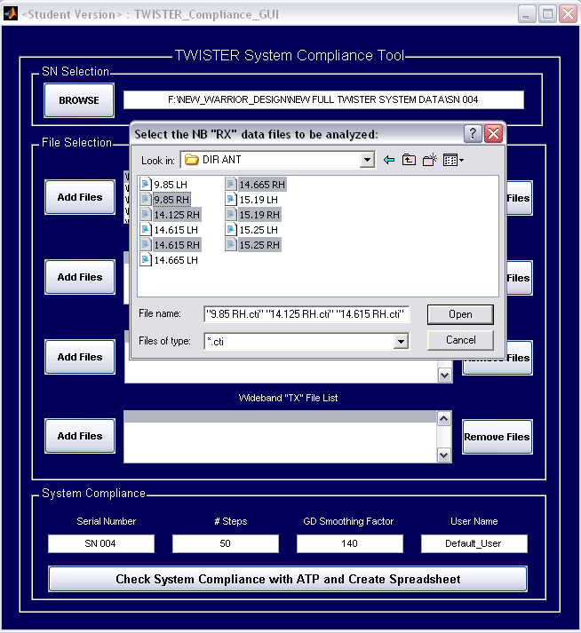
Select NB “TX” antenna data files.

Slide 8
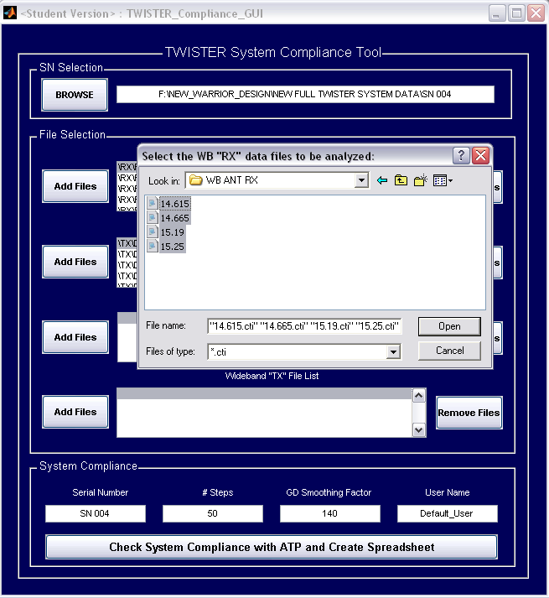
Select WB “TX” antenna data files.

Slide 9
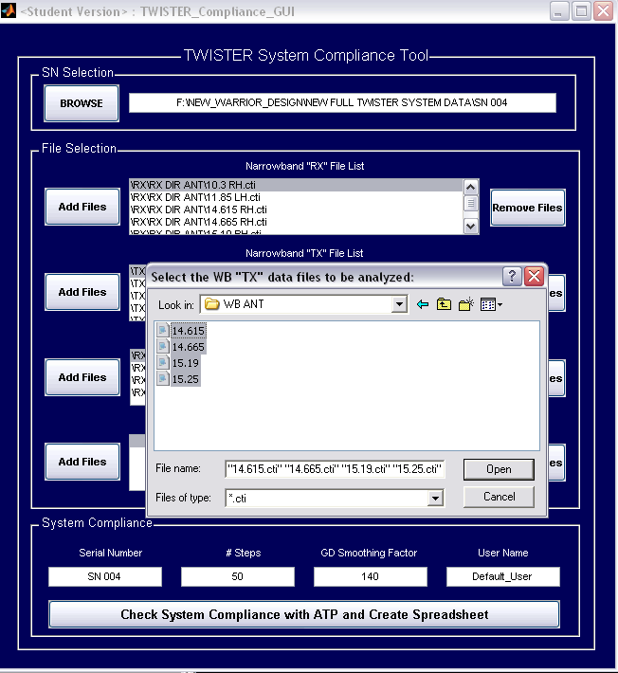
Select WB “TX” antenna data files.

Slide 10
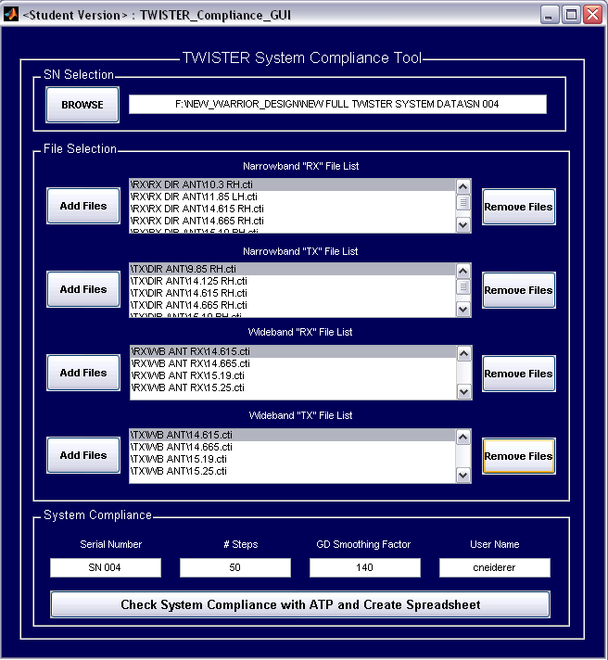
GUI should now show the selected files. Click “Check System Compliance with ATP and Create Spreadsheet” button.

Slide 11
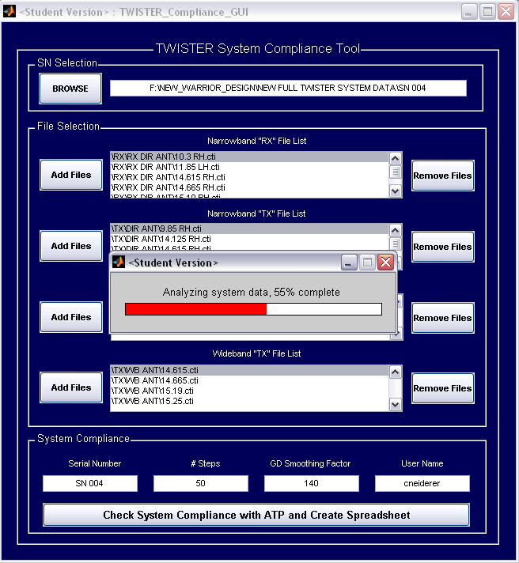
Wait-bar will appear to inform you of progress.

Slide 12
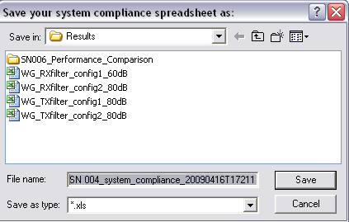
You will then be prompted to name the spreadsheet to save the analysis results.

Slide 13
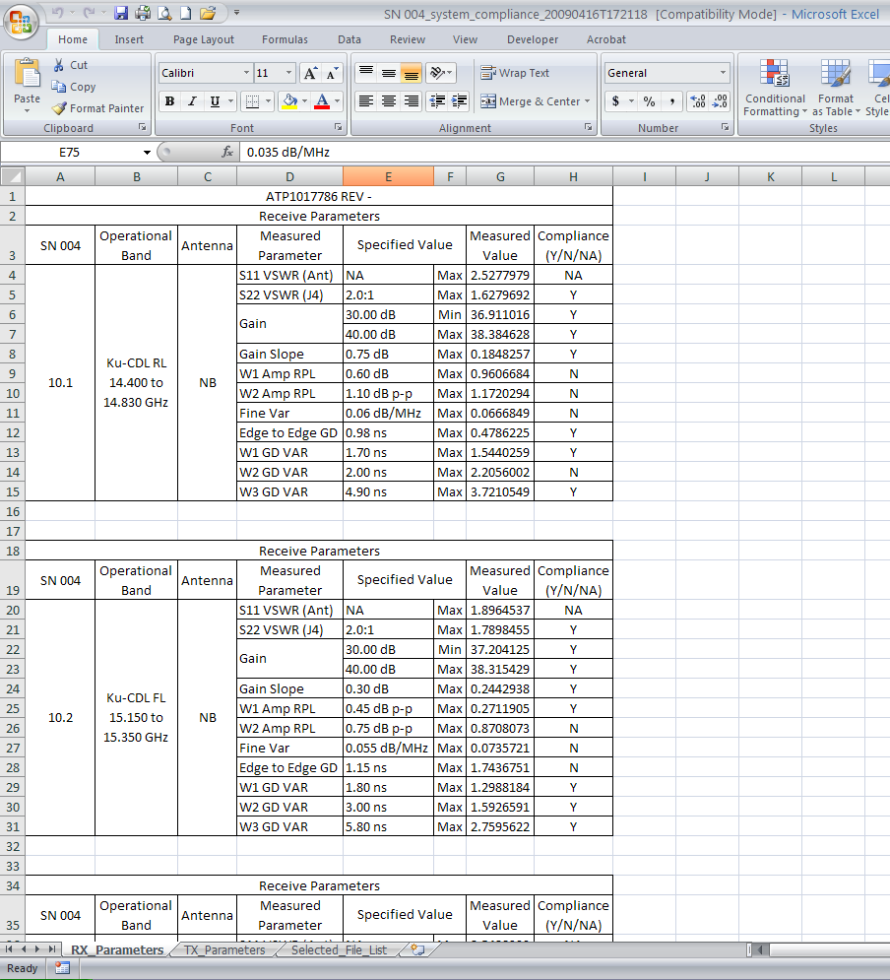
Spreadsheet consists of 3 tabs: RX_Parameters containing “RX” analysis results, both NB & WB antenna data.

Slide 14
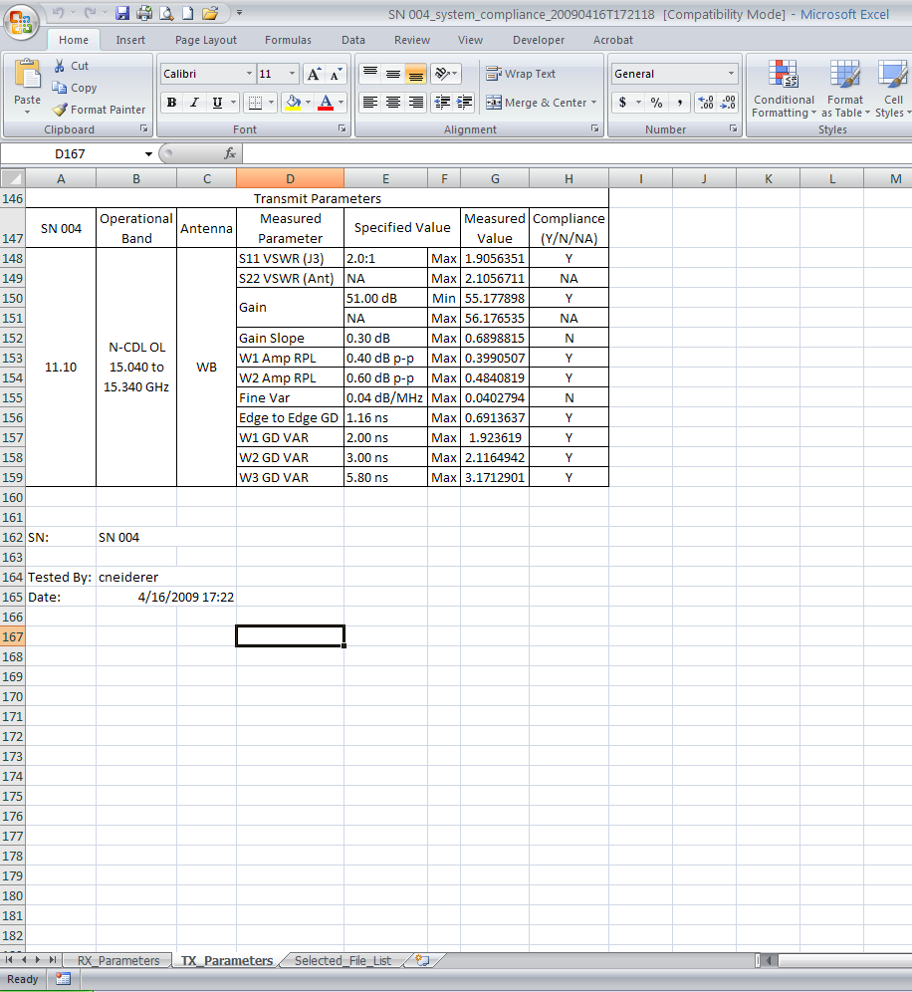
TX_Parameters contain “TX” data analysis results for both NB & WB antennas.

Slide 15
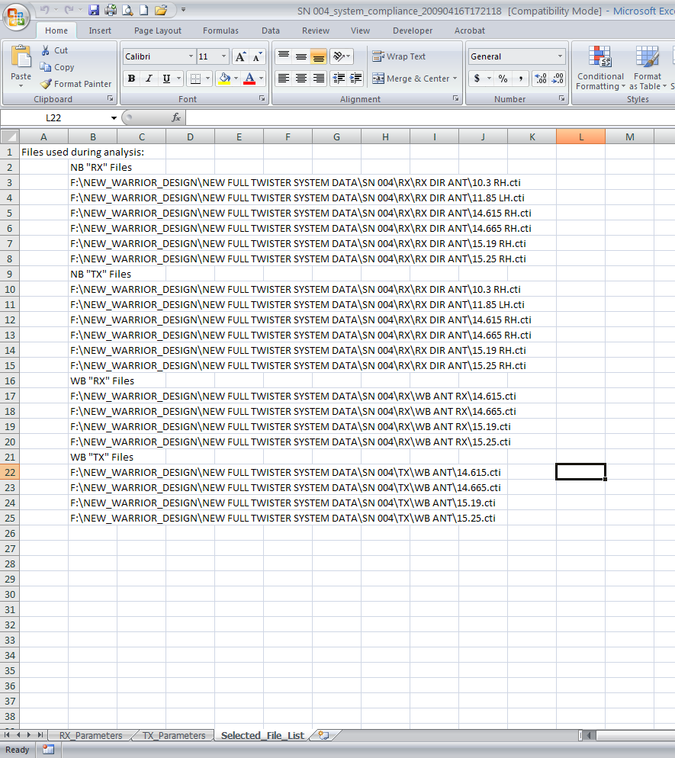
Selected_File_List contains a list of the files used for the analysis.

